Slide 1
Cryptovisor: A Cryptocurrency Advisor Tool
Matthew Baldree
Paul Widhalm
Brandon Hill
Notes:
Good afternoon, my name is _____ and our presentation is on Cryptovisor, a tool that provides trading recommendations for cryptocurrency using a stochastic gradient boost classifier trained from a model labeled by technical indicators

Slide 2
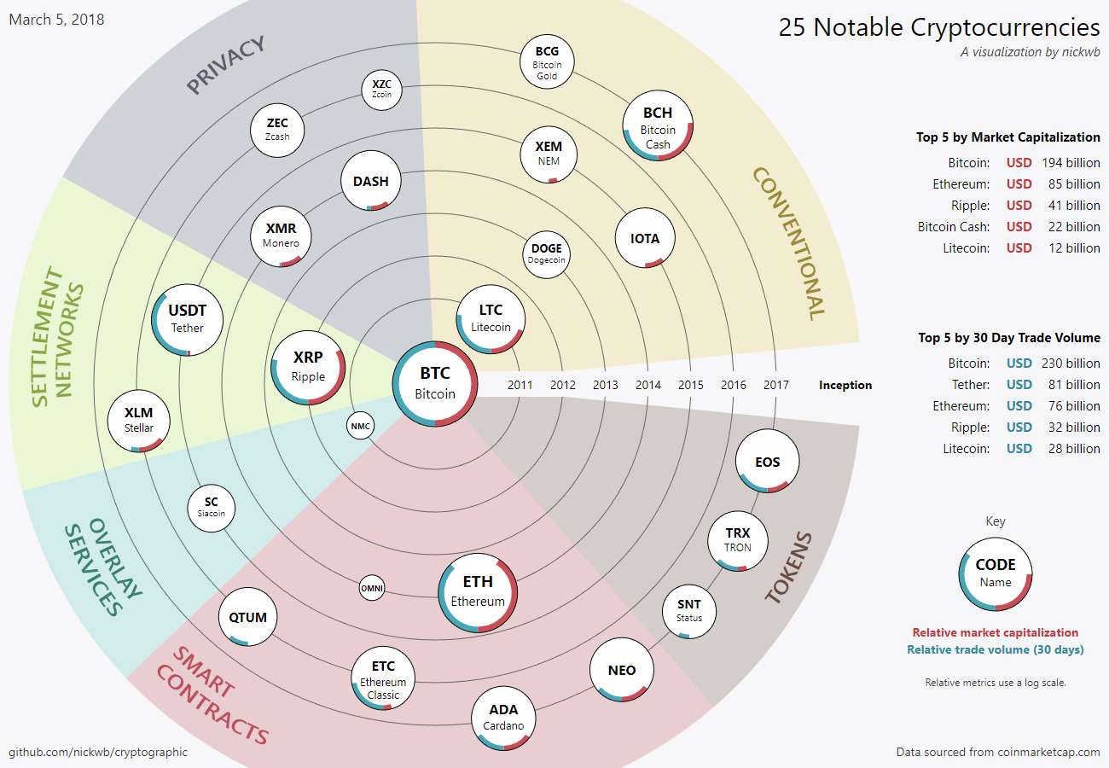
Cryptocurrencies (Crypto)
Notes:
Cryptocurrency is an asset designed to be used as digital currency.
The asset is a chain of digital signatures that exist in binary format secured by cryptography with the right to use.
There are two kinds of cryptos today: coin and token, totaling over 1,500 cryptos.
All cryptos are not the same. Some are focused on different problems on top of currency concerns such as privacy, smart contracts, tokens.

Slide 3
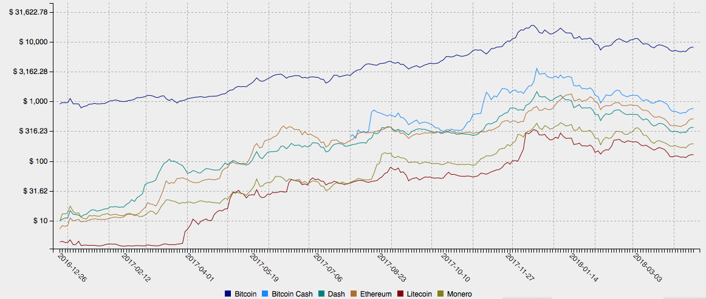
Market
Notes:
Many of the cryptos are traded on many of the 5,400 exchanges totaling in 2017 a market capitalization of $821B at its all time high.
This graph shows the price over the last year of the major cryptos on a log scale.
The cryptocurrency market is volatile due to its infancy and limited size making it difficult for investors to know when to enter, exit, or stay in the market.

Slide 4
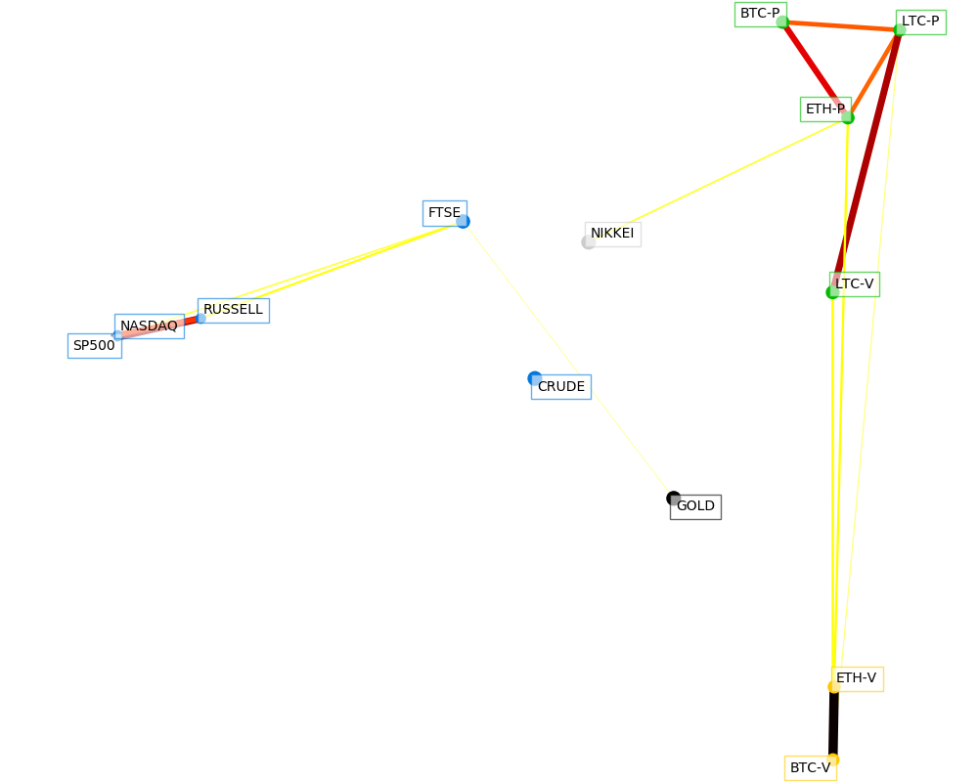
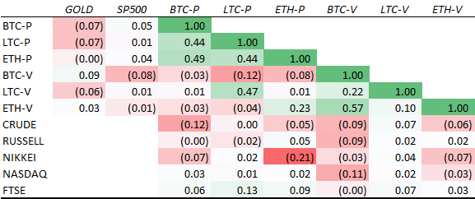
Commodity?
Notes:
From our analysis, we conclude that Bitcoin is a unique asset providing a hedge against other assets.

Slide 5
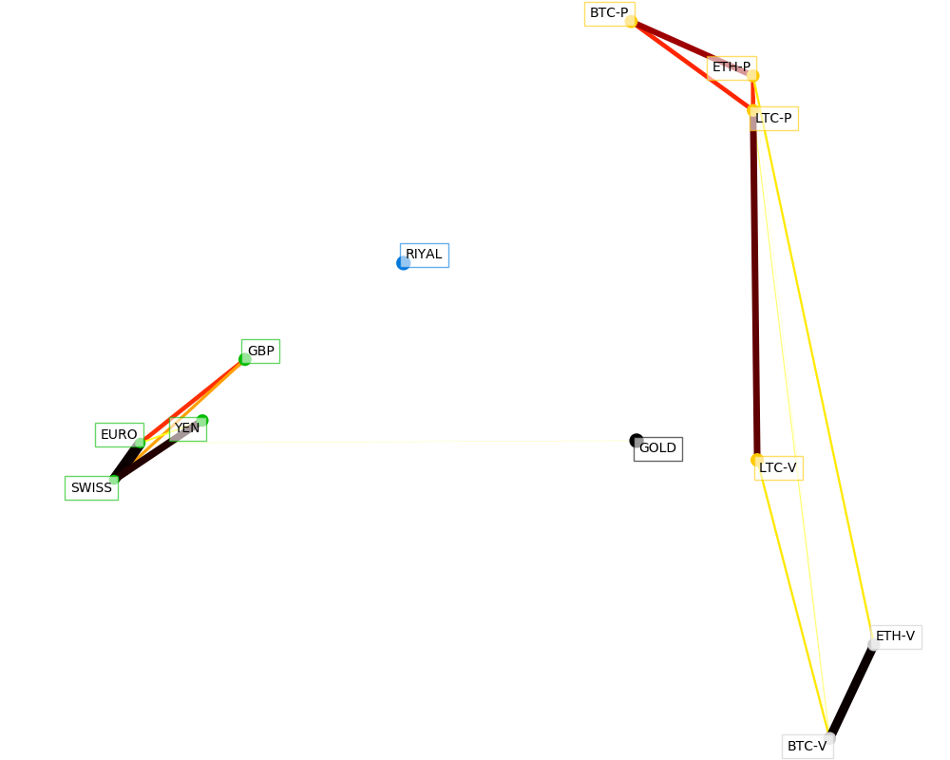
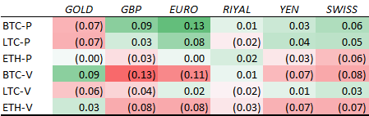
Fiat?

Slide 6
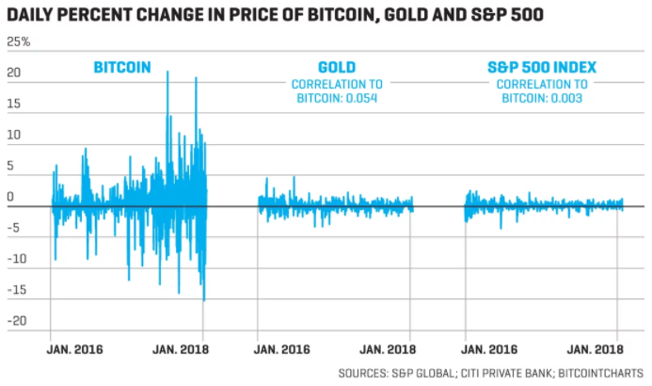
Volatile?
Notes:
As a young asset, it lacks economic fundamentals making it very difficult to predict.
Correlation is a major factor
Marketcap alone will not work
Wild fluctuation causes inconsistent data distribution

Slide 7
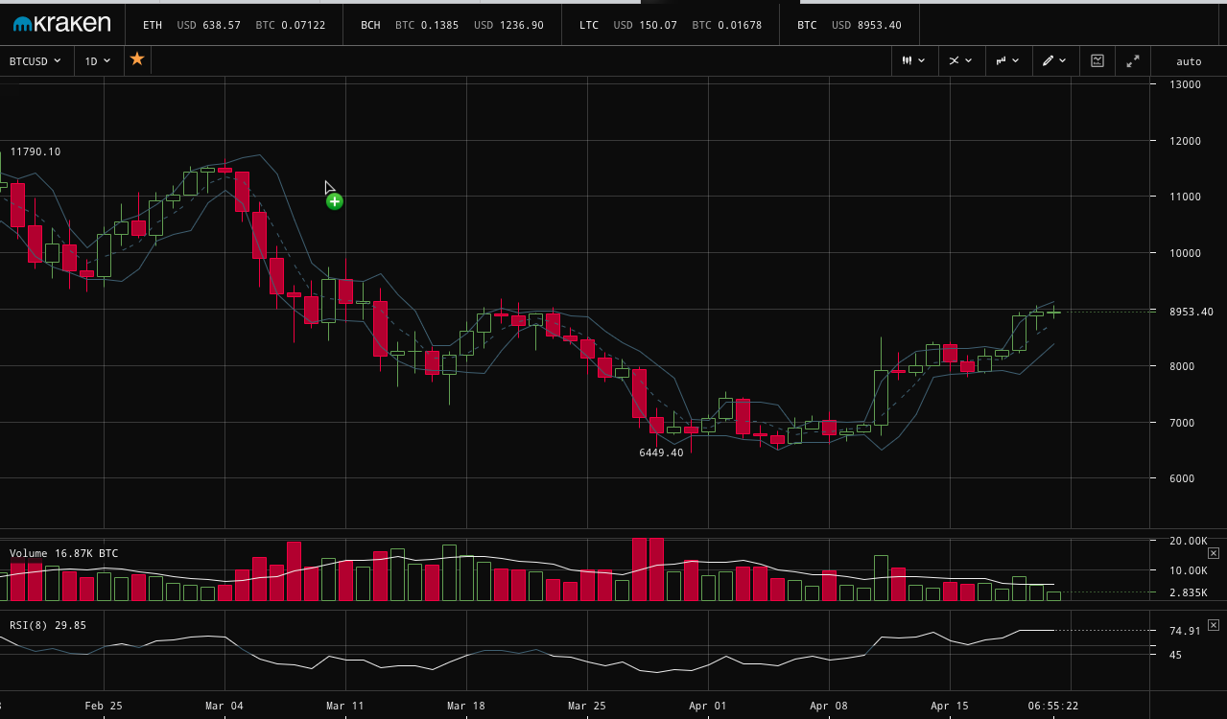
Investing in Crypto
Notes:
Volatility makes the market impossible to forecast and difficult for an investor to know when to Buy, Sell or Hold cryptos
Algorithmic traders are involved

Slide 8
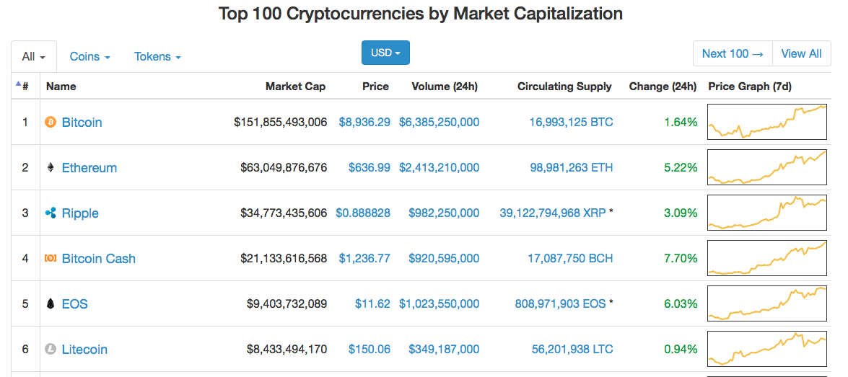
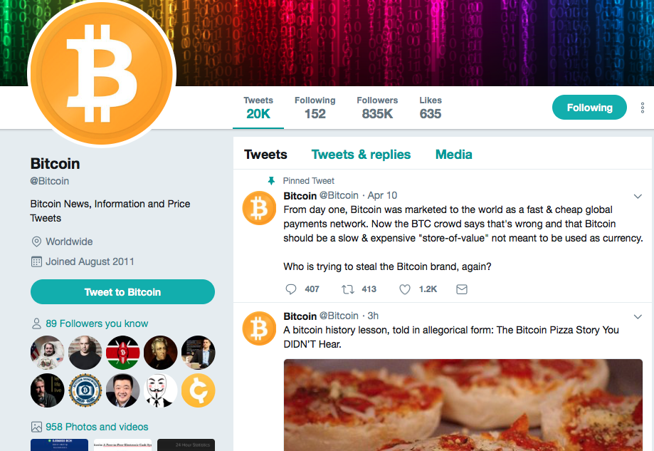
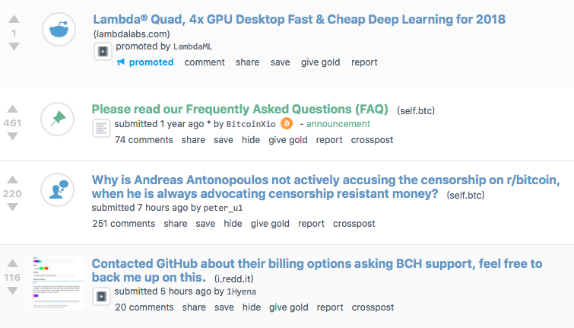
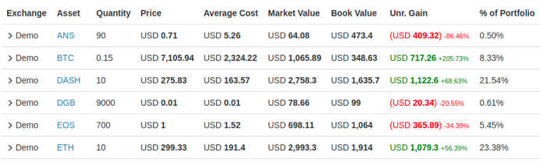
Investment Tools
Notes:
Trading chart tools
Market capitalization, price, 24h volume, supply, price change, price trend
Reddit news
Twitter news
Portfolio tracking
There is not a comprehensive tool that exists
Limited in their use of market indicators
There is not a comprehensive tool that exists
Limited in their use of market indicators
Hype around crypto
News and rumors happen at any time and are a driving force to multi-day horizons

Slide 9
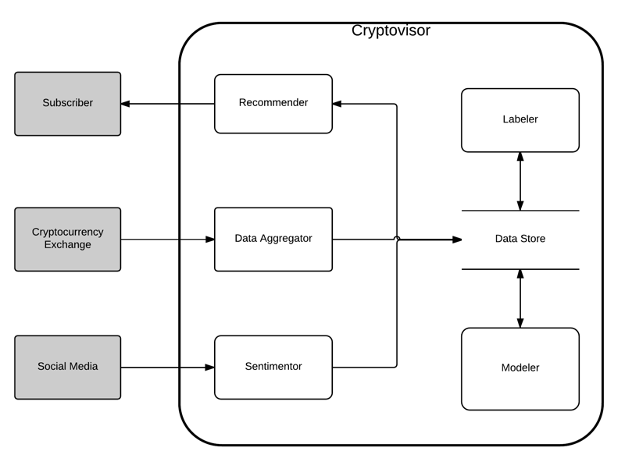
Cryptovisor
Notes:
Recommender
Data aggregator
Sentimentor
Labeler
Data store
Modeler

Slide 10
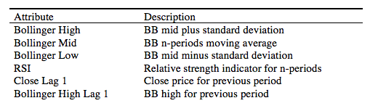
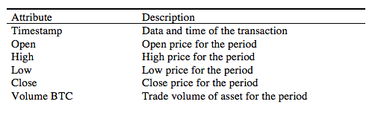
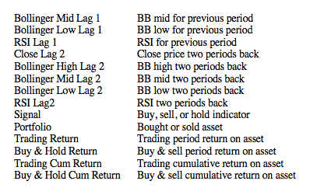
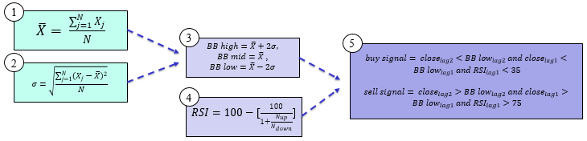
Labeler
Notes:
For each time series data point, the moving average (1), standard deviation (2), Bollinger Bands (BB) (3), Relative Strength Indicator (RSI) are created. BB are volatility lines created from a close price moving average and its standard deviation. Relative Strength Indicator (RSI) is a momentum oscillator that measures speed and change of price movements between zero and 100. N is the average days up or down closes. Trading signals are generated followed by the returns and compared with a buy and hold strategy to ensure trading signals yield comparable results.

Slide 11
Labeler
Notes:
For each time series data point, the moving average (1), standard deviation (2), Bollinger Bands (BB) (3), Relative Strength Indicator (RSI) are created. BB are volatility lines created from a close price moving average and its standard deviation. Relative Strength Indicator (RSI) is a momentum oscillator that measures speed and change of price movements between zero and 100. N is the average days up or down closes. Trading signals are generated followed by the returns and compared with a buy and hold strategy to ensure trading signals yield comparable results.

Slide 12
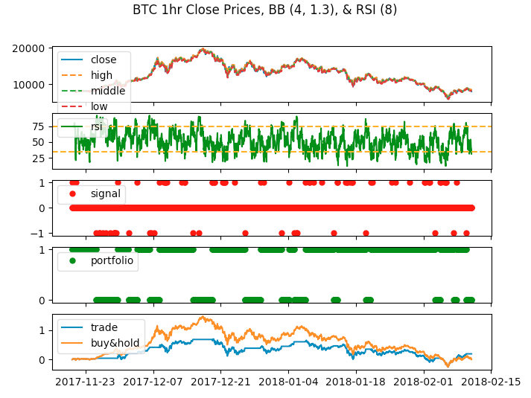
Trading Strategy
Notes:
Timestamp
Open
High
Low
Close
Volume
Historical exchange price data from cryptocompare API
10/3/2016 to 2/10/2018
Hourly data
Read into labeler

Slide 13
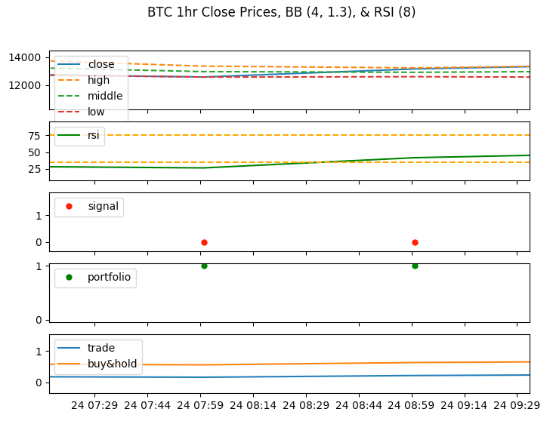
Labeler
Notes:
For each time series data point, the moving average (1), standard deviation (2), Bollinger Bands (BB) (3), Relative Strength Indicator (RSI) are created. BB are volatility lines created from a close price moving average and its standard deviation. Relative Strength Indicator (RSI) is a momentum oscillator that measures speed and change of price movements between zero and 100. N is the average days up or down closes. Trading signals are generated followed by the returns and compared with a buy and hold strategy to ensure trading signals yield comparable results.

Slide 14
Labeler
Labels
Notes:
For each time series data point, the moving average (1), standard deviation (2), Bollinger Bands (BB) (3), Relative Strength Indicator (RSI) are created. BB are volatility lines created from a close price moving average and its standard deviation. Relative Strength Indicator (RSI) is a momentum oscillator that measures speed and change of price movements between zero and 100. N is the average days up or down closes. Trading signals are generated followed by the returns and compared with a buy and hold strategy to ensure trading signals yield comparable results.

Slide 15
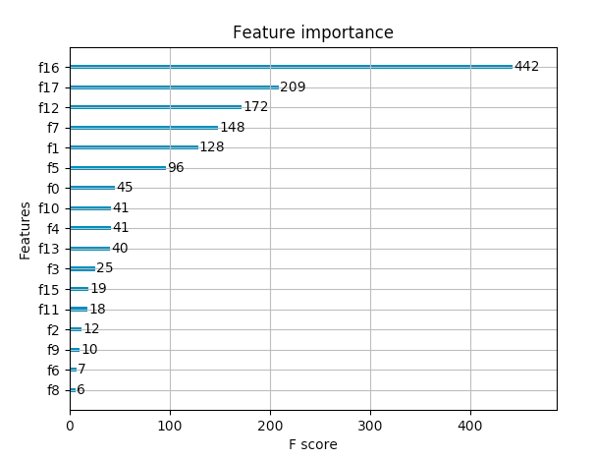
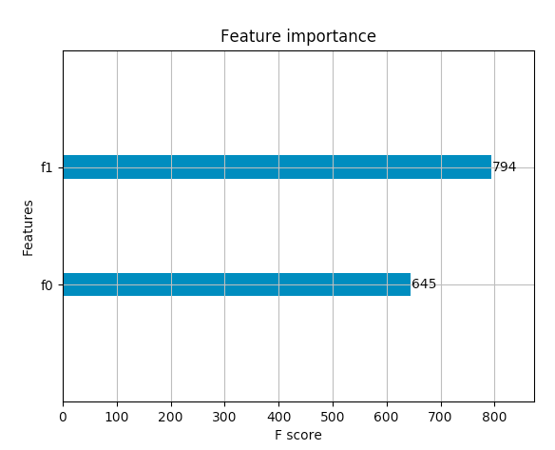
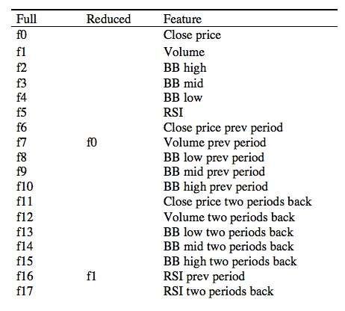
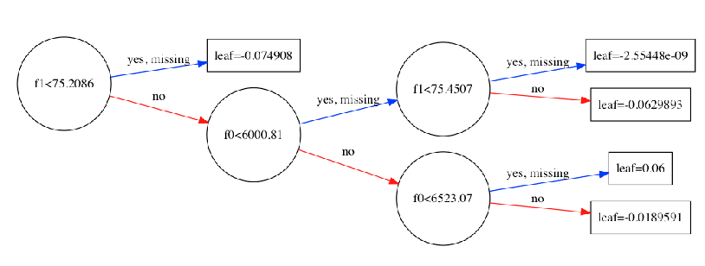
Modeler
Notes:
F0 – prev volume
F1 – prev rsi

Slide 16
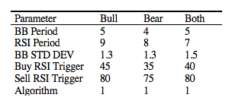
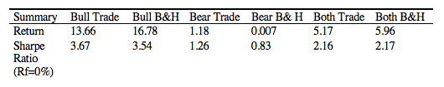
Bear, Bull or Both Markets
324 scenarios each

Slide 17
Future Work
Other Currencies
Other Technical Indicators
Sampling and Training
Notes:
Other Currencies
-Is this approach applicable to all other currencies?
-Where is it different?
Technical Indicators
-Over 90 TI
-Which ones work best?
-Which combination?
Sampling and Training
-Which sampling works best?
-Which training window works best?

Slide 18
Sentiment
Notes:
Not enough research in the field yet
Twitter, google, yahoo search trends
Cryptocompare’s Sentiment Engine

Slide 19
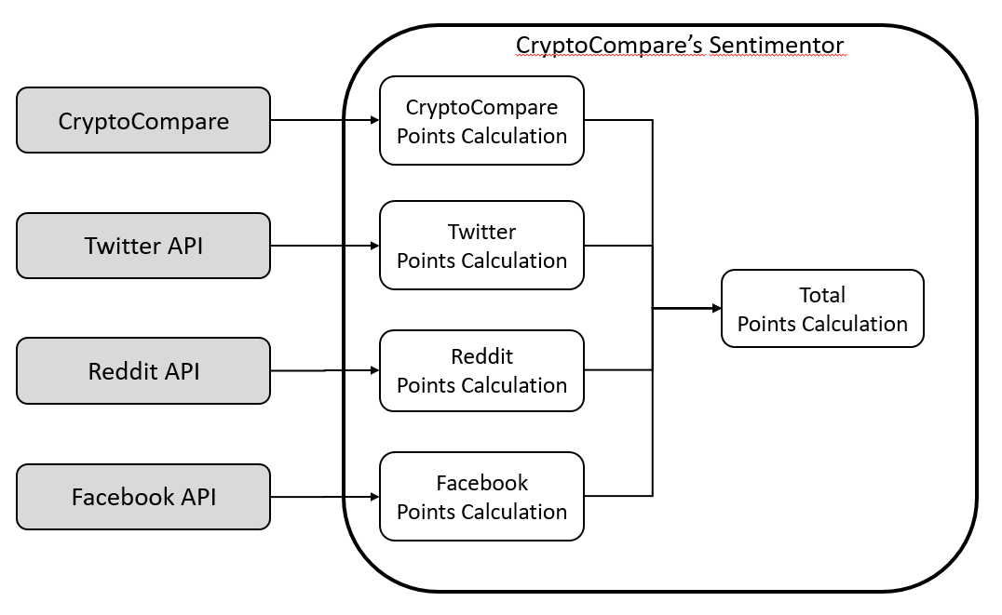
Sentiment
Notes:
Not enough research in the field yet
Twitter, google, yahoo search trends
Cryptocompare’s Sentiment Engine

Slide 20
Finish System

Slide 21
Conclusion
Crypto market is young, volatile and risky
Market is a new asset class that needs more tools for investors
Cryptovisor is a recommendation tool that utilizes momentum technical indicators based on historical trading data to recommend buy, sell, and hold trades
Notes:
By leveraging technical momentum indicators to provide buy, sell, and hold markers or labels, a tool can be developed that performs as good or better than a buy and hold trading strategy in a bear market, bull market or both markets.

